Slide 1
Secure System for IOT Devices
Access to IOT device hub protected by radius authentication through Aruba IAP and central.

Slide 2
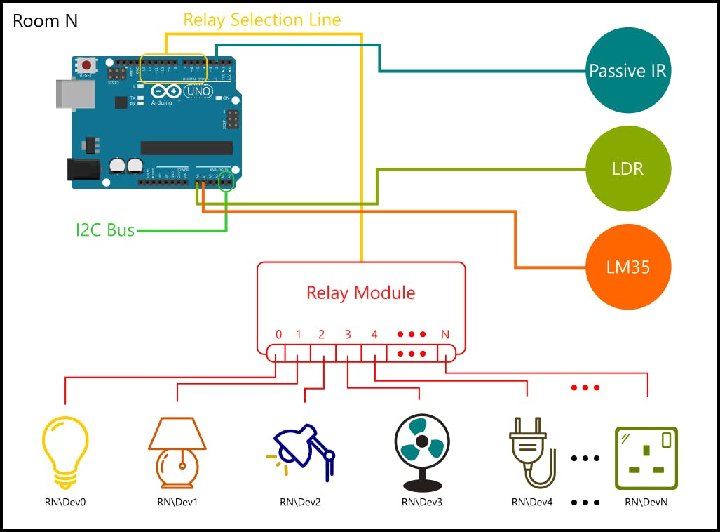
IOT device hub

Slide 3
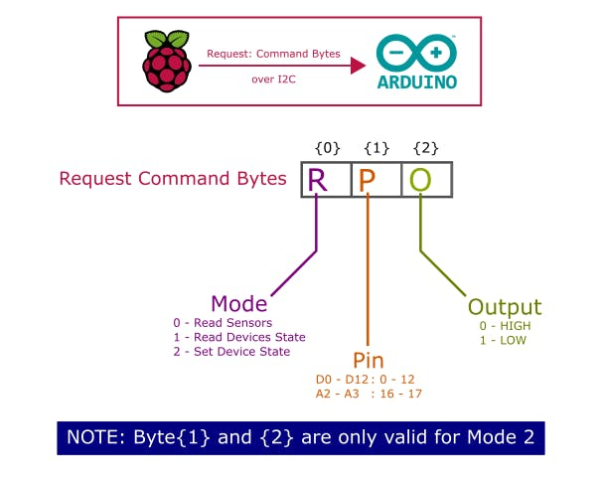
Device Hub controlled by Rasberry-PI

Slide 4
Securing IOT hubs
IOT devices usually come with their own app / hardware remote and optionally some API to integrate with some dashboard
As the user base grows for IOT device access, we need a way to regularize who gets what access etc., by imposing a process on top.
We are adding centralized app with that integrates with Aruba IAP and RADIUS[1] authentication.
[1] http://networkradius.com/doc/FreeRADIUS%20Technical%20Guide.pdf

Slide 5
Tech Stack
Aruba IAP
Rasberry-PI https://projects.raspberrypi.org/en/projects/raspberry-pi-getting-started
Python https://docs.python.org/2.7/tutorial/introduction.html
freeradius https://wiki.freeradius.org/Home
Angular JS https://docs.angularjs.org/tutorial/
Bootstrap http://getbootstrap.com/docs/4.0/layout/overview/

Slide 6
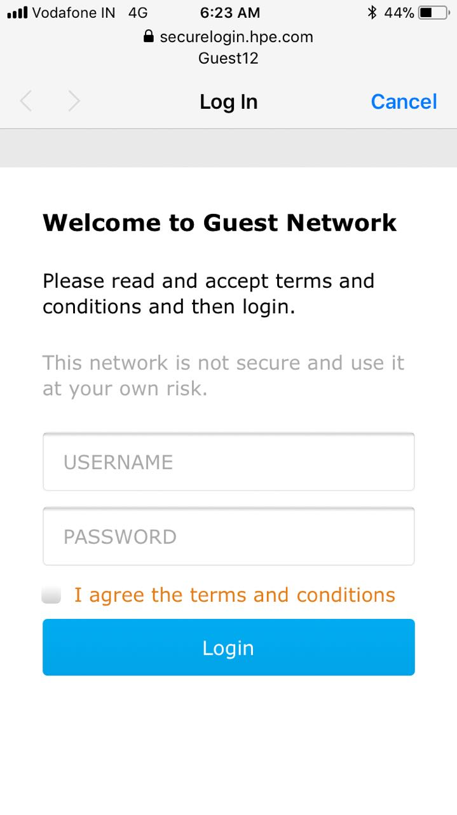
Login using Aruba IAP

Slide 7
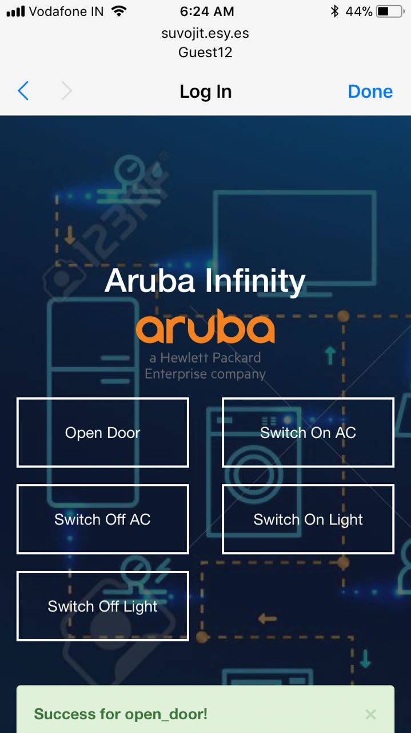
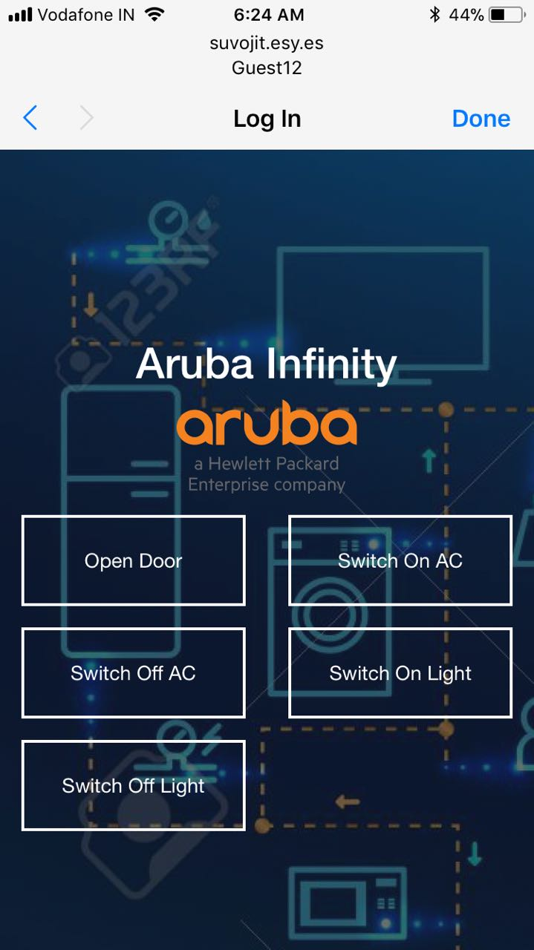
View / Operate IOT devices

Slide 8
Q & A

Slide 9
Thank you

